Slide 1
CAR RENTALS IN USA
ELIZABETH SESEBOR
06 November 2022.

Slide 2
Executive summary
This report gives an understanding of the rate of car rentage in most cities in United States.
We have been able to identify;
Which car makes and models are popular in US and in which cities.
The typical fare for renting a car in various major cities.
The most and least expensive rented cars
The most expensive and the cheapest cities for car rentals.

Slide 3
methodology
Source Data:
Website
Data Collection:
Downloaded excel file (2020 dataset)
Data Wrangling and Exploratory analysis:
Finding and dropping duplicates, replacing missing values
Data Visualization:
Python (seaborn and matplotlib libraries)

Slide 4
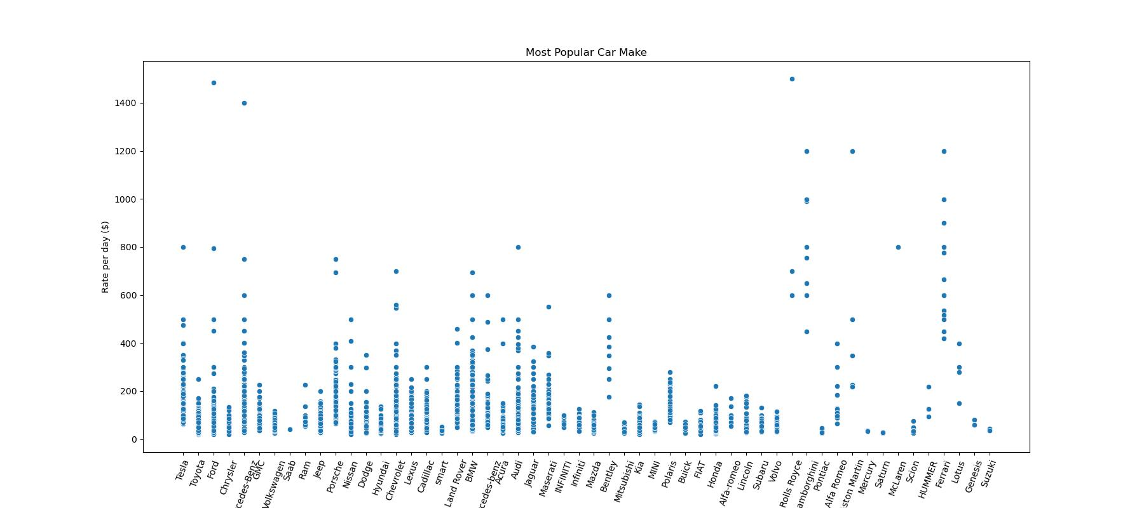
results
According to my analysis, in the United States, Tesla is the most popular or most rented car followed by Toyota and Ford while Suzuki is the least rented car in next to Genesis and Lotus.
But in terms of rent price, the most expensive are Rolls Royce ($1,500/day), Mecedes-Benz($1,400/day), and Ford. To mention a few. The cheapest cars for rent are Saturn, Mecury, Saab with less than $50/day.

Slide 5
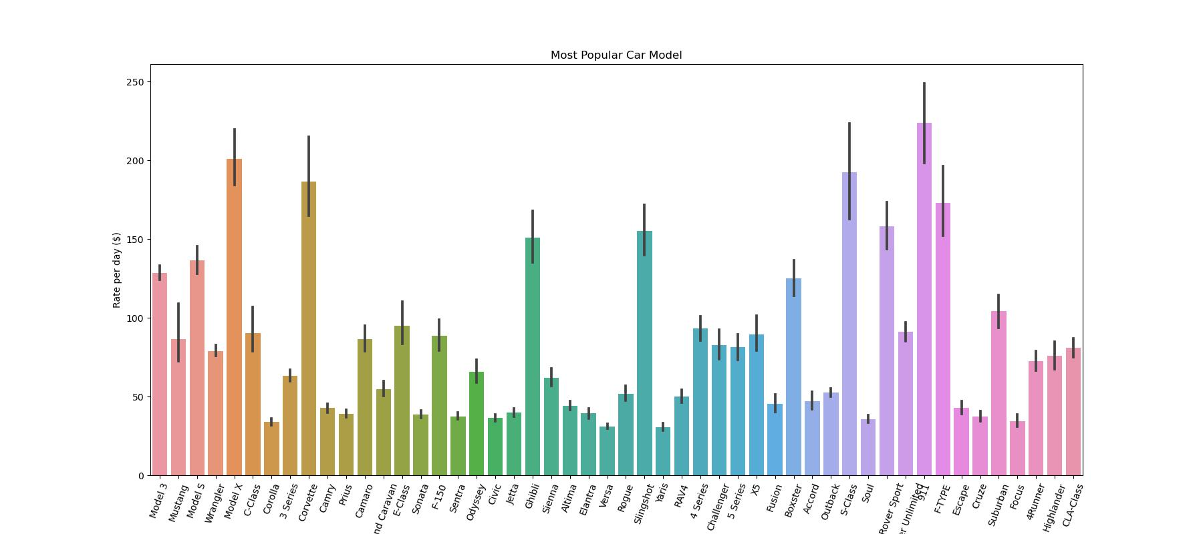
results
This graph shows the model of cars and apparently Model-3, Mustang, Model-S are the top 3 popular model of cars rented. CLA-Class, Highlander and 4Runner as the least model of cars rented.
The most expensive model of cars are 911(Porshe), Wrangler Unlimited(Jeep), Model-X(tesla) and the cheapest model of cars for rent are Versa(Nissan), Yaris(Toyota), and Corolla(Toyota).

Slide 6
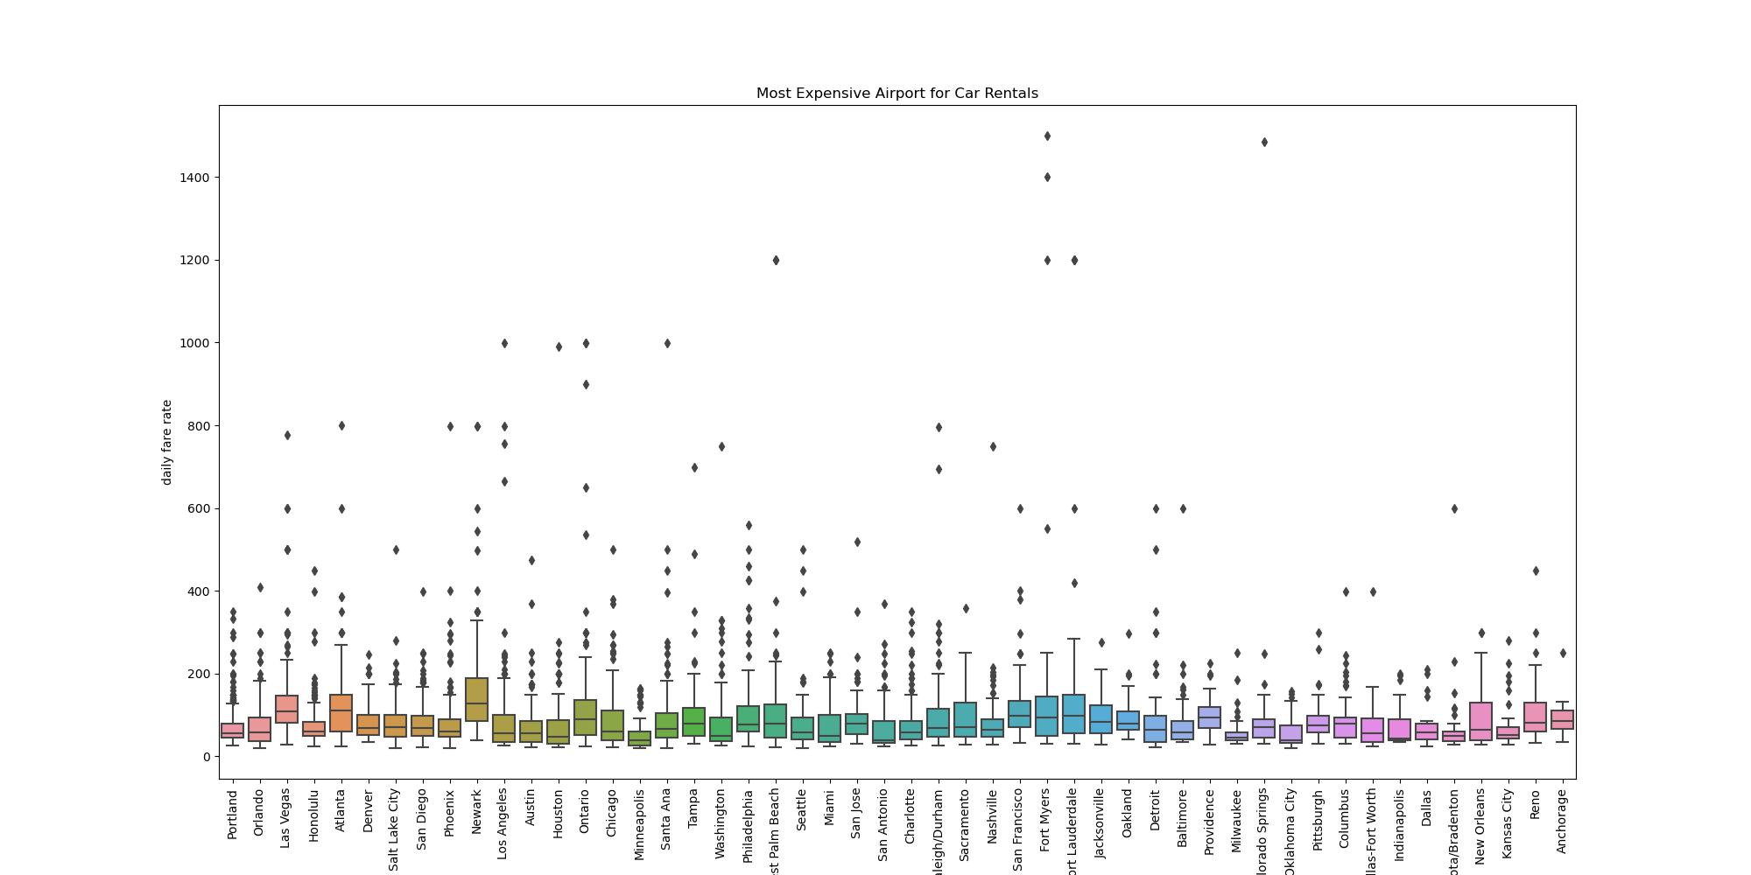
results
The airports that has ponderous traffic for car rentals on a daily basis are Portland, Olando, Las-vegas and Honolulu. Anchorage airport being the least patronized in car rentals.
Newark airport happens to be the most expensive followed by Fort Lauderdale and Atlanta while Milwaukee and Serasota/Bradenton airports are the two cheapest airports for car rental.

Slide 7
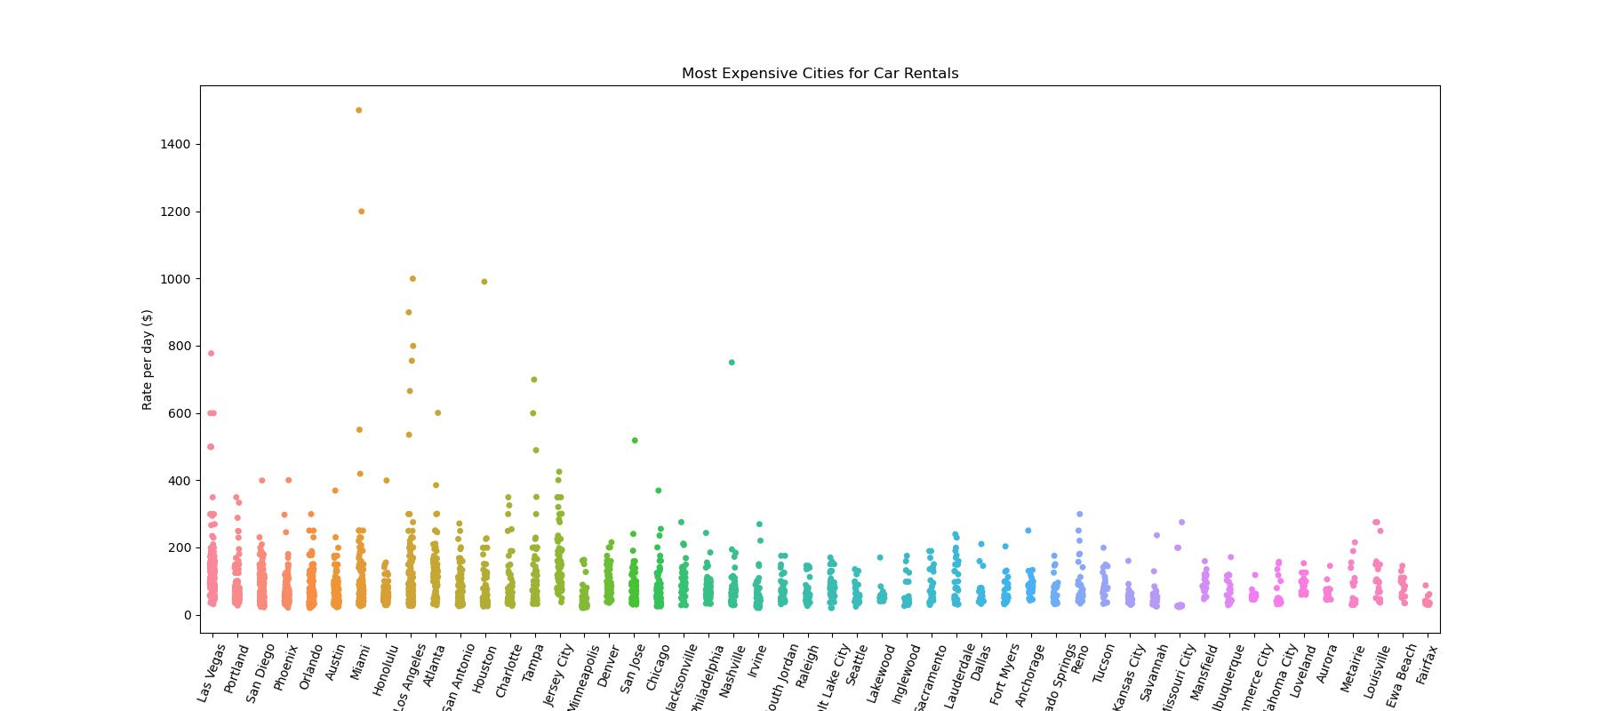
results
Popular cities for car rental are Las-vegas, Portland and San Diego. Firfax, Ewa Beach, and Louisville are least popular for car rentals.
The most expensive cities for car rentals are Miami, Los-Angeles, Las-vegas, and Tampa with average rate of $800-1500. Missouri City as the cheapest city for car rental

Slide 8
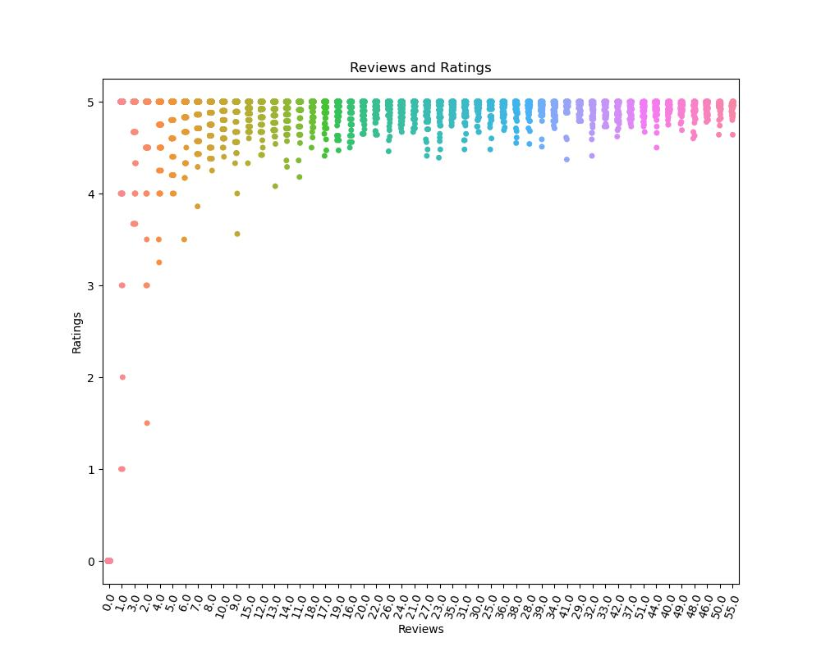
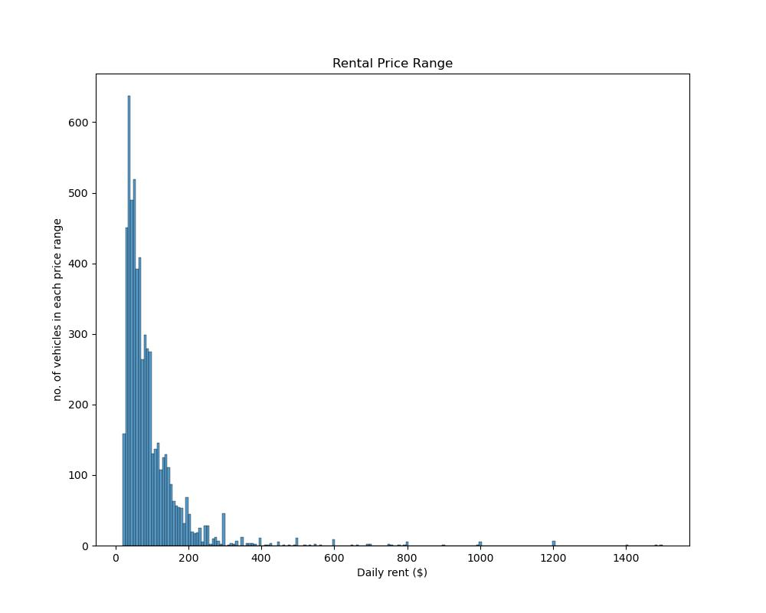
results
The first graph shows the correlation between the reviews and ratings of the trips. The analysis depicted the correlation coefficient to be 0.24 which means there are no linear relationship between the two.
Most ratings are 5stars and has up to 100 reviews.
On the other hand, the second graph is the price range of the car rentals. And the typical prices for rent is between $20 to $100.

Slide 9
conclusion
Tesla still stands as the most desired car in US. There are other luxury cars like rolls-Royce, lanbogini, jeep etc which are not often patronized. The rate for rental is affordable considering the location. Every renter happens to enjoy the cars and their trips, meaning the maintenance and service from the rental company is commendable.

